Slide 1


Application Security
Prepared by:
Dr. Avita Katal
Assistant Professor (SG)
School of Computer Science
UPES, Dehradun

Slide 2

Introduction
Application security in cloud computing is a critical aspect of ensuring the protection, confidentiality, integrity, and availability of applications and data in cloud environments. As organizations increasingly migrate their applications and services to the cloud, understanding and implementing robust application security measures become paramount.
Application security refers to the set of measures and practices implemented to protect software applications from potential threats and vulnerabilities that could compromise the confidentiality, integrity, and availability of data or the functionality of the application. The goal of application security is to identify, address, and prevent security risks at every stage of the software development lifecycle, ensuring that applications are robust, resilient, and resistant to malicious attacks.

Slide 3
Application Security-Best Practices
AWS Best practices
Train for application security
Automate testing throughout the development and release lifecycle
Perform regular penetration testing
Manual code reviews
Centralize services for packages and dependencies
Deploy software programmatically
Regularly assess security properties of the pipelines
Build a program that embeds security ownership in workload teams
Notes:
SEC11-BP01 Train for application security:
Ensure that development and operations teams are adequately trained in application security. This includes understanding common security vulnerabilities, secure coding practices, and the proper use of security tools.
SEC11-BP02 Automate testing throughout the development and release lifecycle:
Integrate automated security testing into the entire development and release process. This includes static analysis tools for code scanning, dynamic analysis tools for runtime testing, and other automated security testing tools to identify and address vulnerabilities early in the development lifecycle.
SEC11-BP03 Perform regular penetration testing:
Conduct regular penetration testing to simulate real-world attacks and identify potential vulnerabilities that automated tools may not catch. This helps ensure a more comprehensive security assessment of your applications.
SEC11-BP04 Manual code reviews:
Supplement automated testing with manual code reviews conducted by experienced security experts. Human review can often catch nuanced security issues that automated tools might miss.
SEC11-BP05 Centralize services for packages and dependencies:
Centralize the management of software packages and dependencies to have better control over the components used in your applications. This helps in tracking and updating dependencies to patch known vulnerabilities.
SEC11-BP06 Deploy software programmatically:
Automate the deployment process to reduce the risk of human error and ensure consistent, secure configurations. This can include using infrastructure as code (IaC) tools to define and deploy infrastructure and applications.
SEC11-BP07 Regularly assess security properties of the pipelines:
Regularly review and assess the security properties of your continuous integration/continuous deployment (CI/CD) pipelines. Ensure that security is integrated into the pipeline, and any changes are subject to security checks before deployment.
SEC11-BP08 Build a program that embeds security ownership in workload teams:
Promote a culture of security ownership within development and operations teams. Encourage cross-functional collaboration and make each team responsible for the security of their own workloads. This helps foster a proactive and shared responsibility for security.

Slide 4
Application Security-Best Practices
AWS Best practices
Train for application security
Provide training to the builders in your organization on common practices for the secure development and operation of applications. Adopting security focused development practices helps reduce the likelihood of issues that are only detected at the security review stage.
Automate testing throughout the development and release lifecycle
Automate the testing for security properties throughout the development and release lifecycle. Automation makes it easier to consistently and repeatably identify potential issues in software prior to release, which reduces the risk of security issues in the software being provided.
Perform regular penetration testing
Perform regular penetration testing of your software. This mechanism helps identify potential software issues that cannot be detected by automated testing or a manual code review. It can also help you understand the efficacy of your detective controls. Penetration testing should try to determine if the software can be made to perform in unexpected ways, such as exposing data that should be protected, or granting broader permissions than expected.
Manual code reviews
Perform a manual code review of the software that you produce. This process helps verify that the person who wrote the code is not the only one checking the code quality
Notes:
Best practices
SEC11-BP01 Train for application security
SEC11-BP02 Automate testing throughout the development and release lifecycle
SEC11-BP03 Perform regular penetration testing
SEC11-BP04 Manual code reviews
SEC11-BP05 Centralize services for packages and dependencies
SEC11-BP06 Deploy software programmatically
SEC11-BP07 Regularly assess security properties of the pipelines
SEC11-BP08 Build a program that embeds security ownership in workload teams

Slide 5
Application Security-Best Practices
AWS Best practices
Centralize services for packages and dependencies
Provide centralized services for builder teams to obtain software packages and other dependencies. This allows the validation of packages before they are included in the software that you write, and provides a source of data for the analysis of the software being used in your organization.
Deploy software programmatically
Perform software deployments programmatically where possible. This approach reduces the likelihood that a deployment fails or an unexpected issue is introduced due to human error.
Regularly assess security properties of the pipelines
Apply the principles of the Well-Architected Security Pillar to your pipelines, with particular attention to the separation of permissions. Regularly assess the security properties of your pipeline infrastructure. Effectively managing the security of the pipelines allows you to deliver the security of the software that passes through the pipelines.
Build a program that embeds security ownership in workload teams
Build a program or mechanism that empowers builder teams to make security decisions about the software that they create. Your security team still needs to validate these decisions during a review, but embedding security ownership in builder teams allows for faster, more secure workloads to be built. This mechanism also promotes a culture of ownership that positively impacts the operation of the systems you build.
Notes:
Best practices
SEC11-BP01 Train for application security
SEC11-BP02 Automate testing throughout the development and release lifecycle
SEC11-BP03 Perform regular penetration testing
SEC11-BP04 Manual code reviews
SEC11-BP05 Centralize services for packages and dependencies
SEC11-BP06 Deploy software programmatically
SEC11-BP07 Regularly assess security properties of the pipelines
SEC11-BP08 Build a program that embeds security ownership in workload teams

Slide 6
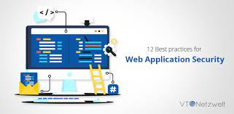
What types of Applications need to be secure?
Web Application Security
API Security
Cloud Native application security
Web Application Security
A web application is software that runs on a web server and is accessible via the Internet. The client runs in a web browser.
By nature, applications must accept connections from clients over insecure networks. This exposes them to a range of vulnerabilities.
Many web applications are business critical and contain sensitive customer data, making them a valuable target for attackers and a high priority for any cyber security program.
The evolution of the Internet has addressed some web application vulnerabilities – such as the introduction of HTTPS, which creates an encrypted communication channel that protects against man in the middle (MitM) attacks. However, many vulnerabilities remain. The most severe and common vulnerabilities are documented by the Open Web Application Security Project (OWASP), in the form of the OWASP Top 10.

Slide 7
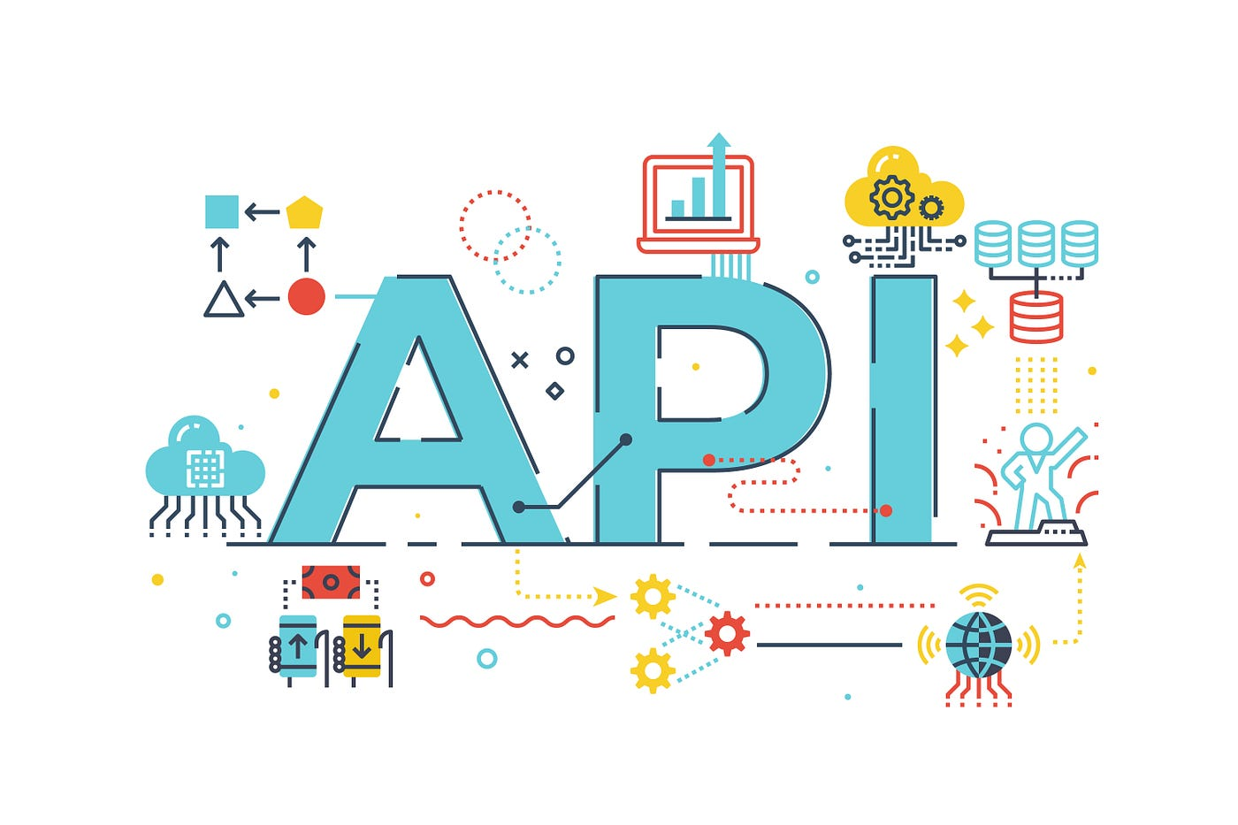
What types of Applications need to be secure?
API Security
Application Programming Interfaces (API) are growing in importance. They are the basis of modern microservices applications, and an entire API economy has emerged, which allows organizations to share data and access software functionality created by others. This means API security is critical for modern organizations.
APIs that suffer from security vulnerabilities are the cause of major data breaches. They can expose sensitive data and result in disruption of critical business operations. Common security weaknesses of APIs are weak authentication, unwanted exposure of data, and failure to perform rate limiting, which enables API abuse.
Like web application security, the need for API security has led to the development of specialized tools that can identify vulnerabilities in APIs and secure APIs in production.
Notes:
Web Application Security
A web application is software that runs on a web server and is accessible via the Internet. The client runs in a web browser. By nature, applications must accept connections from clients over insecure networks. This exposes them to a range of vulnerabilities. Many web applications are business critical and contain sensitive customer data, making them a valuable target for attackers and a high priority for any cyber security program.
The evolution of the Internet has addressed some web application vulnerabilities – such as the introduction of HTTPS, which creates an encrypted communication channel that protects against man in the middle (MitM) attacks. However, many vulnerabilities remain. The most severe and common vulnerabilities are documented by the Open Web Application Security Project (OWASP), in the form of the OWASP Top 10.
Due to the growing problem of web application security, many security vendors have introduced solutions especially designed to secure web applications. Examples include the web application firewall (WAF), a security tool designed to detect and block application-layer attacks.
Learn more in our detailed guide to website security
API Security
Application Programming Interfaces (API) are growing in importance. They are the basis of modern microservices applications, and an entire API economy has emerged, which allows organizations to share data and access software functionality created by others. This means API security is critical for modern organizations.
APIs that suffer from security vulnerabilities are the cause of major data breaches. They can expose sensitive data and result in disruption of critical business operations. Common security weaknesses of APIs are weak authentication, unwanted exposure of data, and failure to perform rate limiting, which enables API abuse.
Like web application security, the need for API security has led to the development of specialized tools that can identify vulnerabilities in APIs and secure APIs in production.
Learn more in the detailed guide to API Security
Cloud Native Application Security
Cloud native applications are applications built in a microservices architecture using technologies like virtual machines, containers, and serverless platforms. Cloud native security is a complex challenge, because cloud native applications have a large number of moving parts and components tend to be ephemeral—frequently torn down and replaced by others. This makes it difficult to gain visibility over a cloud native environment and ensure all components are secure.
In cloud native applications, infrastructure and environments are typically set up automatically based on declarative configuration—this is called infrastructure as code (IaC). Developers are responsible for building declarative configurations and application code, and both should be subject to security considerations. Shifting left is much more important in cloud native environments, because almost everything is determined at the development stage.
Cloud native applications can benefit from traditional testing tools, but these tools are not enough. Dedicated cloud native security tools are needed, able to instrument containers, container clusters, and serverless functions, report on security issues, and provide a fast feedback loop for developers.
Another important aspect of cloud native security is automated scanning of all artifacts, at all stages of the development lifecycle. Most importantly, organizations must scan container images at all stages of the development process.

Slide 8
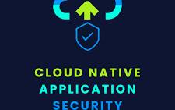
What types of Applications need to be secure?
Cloud Native application security
Cloud native applications are applications built in a microservices architecture using technologies like virtual machines, containers, and serverless platforms.
Cloud native security is a complex challenge, because cloud native applications have a large number of moving parts and components tend to be ephemeral—frequently torn down and replaced by others. This makes it difficult to gain visibility over a cloud native environment and ensure all components are secure.
In cloud native applications, infrastructure and environments are typically set up automatically based on declarative configuration—this is called infrastructure as code (IaC).
Developers are responsible for building declarative configurations and application code, and both should be subject to security considerations. Dedicated cloud native security tools are needed, able to instrument containers, container clusters, and serverless functions, report on security issues, and provide a fast feedback loop for developers.
Another important aspect of cloud native security is automated scanning of all artifacts, at all stages of the development lifecycle.
Notes:
Web Application Security
A web application is software that runs on a web server and is accessible via the Internet. The client runs in a web browser. By nature, applications must accept connections from clients over insecure networks. This exposes them to a range of vulnerabilities. Many web applications are business critical and contain sensitive customer data, making them a valuable target for attackers and a high priority for any cyber security program.
The evolution of the Internet has addressed some web application vulnerabilities – such as the introduction of HTTPS, which creates an encrypted communication channel that protects against man in the middle (MitM) attacks. However, many vulnerabilities remain. The most severe and common vulnerabilities are documented by the Open Web Application Security Project (OWASP), in the form of the OWASP Top 10.
Due to the growing problem of web application security, many security vendors have introduced solutions especially designed to secure web applications. Examples include the web application firewall (WAF), a security tool designed to detect and block application-layer attacks.
Learn more in our detailed guide to website security
API Security
Application Programming Interfaces (API) are growing in importance. They are the basis of modern microservices applications, and an entire API economy has emerged, which allows organizations to share data and access software functionality created by others. This means API security is critical for modern organizations.
APIs that suffer from security vulnerabilities are the cause of major data breaches. They can expose sensitive data and result in disruption of critical business operations. Common security weaknesses of APIs are weak authentication, unwanted exposure of data, and failure to perform rate limiting, which enables API abuse.
Like web application security, the need for API security has led to the development of specialized tools that can identify vulnerabilities in APIs and secure APIs in production.
Learn more in the detailed guide to API Security
Cloud Native Application Security
Cloud native applications are applications built in a microservices architecture using technologies like virtual machines, containers, and serverless platforms. Cloud native security is a complex challenge, because cloud native applications have a large number of moving parts and components tend to be ephemeral—frequently torn down and replaced by others. This makes it difficult to gain visibility over a cloud native environment and ensure all components are secure.
In cloud native applications, infrastructure and environments are typically set up automatically based on declarative configuration—this is called infrastructure as code (IaC). Developers are responsible for building declarative configurations and application code, and both should be subject to security considerations. Shifting left is much more important in cloud native environments, because almost everything is determined at the development stage.
Cloud native applications can benefit from traditional testing tools, but these tools are not enough. Dedicated cloud native security tools are needed, able to instrument containers, container clusters, and serverless functions, report on security issues, and provide a fast feedback loop for developers.
Another important aspect of cloud native security is automated scanning of all artifacts, at all stages of the development lifecycle. Most importantly, organizations must scan container images at all stages of the development process.

Slide 9
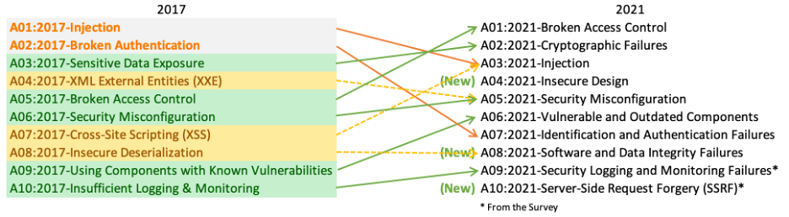
Web Application Security Risks: OWASP Top 10
Broken Access Control
Cryptographic Failures
Injection
Insecure Design
Security Misconfiguration Vulnerable and Outdated Components
Identification and Authentication Failures
Software and Data Integrity Failures -Security Logging and Monitoring Failures Server-Side Request Forgery
https://owasp.org/www-project-top-ten/
Notes:
. OWASP Broken Access Control:
Description:
Broken Access Control occurs when restrictions on what users can or cannot do within an application are not properly enforced.
Unauthorized users might gain access to sensitive data or perform actions they shouldn't be allowed to execute.
Examples:
Inadequate session management, allowing session hijacking.
Insufficient authorization checks, enabling unauthorized access to privileged functionalities.
2. Cryptographic Failures:
Description:
Cryptographic Failures involve weaknesses in the encryption and hashing mechanisms used to protect sensitive data.
Weak cryptographic algorithms or incorrect implementation can compromise the confidentiality and integrity of data.
Examples:
Using weak encryption algorithms.
Inadequate key management practices.
3. Injection:
Description:
Injection attacks occur when untrusted data is sent to an interpreter as part of a command or query, leading to unintended execution of malicious code.
SQL injection and OS command injection are common examples.
Examples:
Inputting malicious SQL queries in user input fields.
Injecting operating system commands through user inputs.
4. Insecure Design:
Description:
Insecure Design refers to flaws in the overall architecture and design of the application.
Security considerations might be neglected during the design phase, leading to vulnerabilities that are challenging to fix later.
Examples:
Lack of proper data validation and sanitization.
Inadequate separation of privileges.
5. Security Misconfiguration:
Description:
Security Misconfiguration occurs when the application, server, or database is not securely configured, leaving it vulnerable to exploitation.
Default settings, unnecessary services, and exposed sensitive information contribute to misconfigurations.
Examples:
Leaving default passwords unchanged.
Allowing directory listing on web servers.
6. Vulnerable and Outdated Components:
Description:
The use of components with known vulnerabilities, such as libraries and frameworks, poses a significant risk.
Failing to update or replace vulnerable components can lead to exploitation.
Examples:
Using outdated third-party libraries.
Ignoring security patches for components.
7. Identification and Authentication Failures:
Description:
Identification and Authentication Failures involve weaknesses in the mechanisms used to verify the identity of users and control their access.
Inadequate authentication processes may allow unauthorized users to gain access.
Examples:
Weak password policies.
Lack of multi-factor authentication.
8. Software and Data Integrity Failures:
Description:
Integrity Failures occur when an attacker can alter data or software without detection.
Tampering with critical data can lead to unauthorized changes and potential exploitation.
Examples:
Insecure data storage mechanisms.
Lack of proper validation for data integrity.
9. Security Logging and Monitoring Failures:
Description:
Security Logging and Monitoring Failures involve insufficient logging and monitoring practices, hindering the detection of security incidents.
Inadequate logging can result in delayed or missed identification of malicious activities.
Examples:
Insufficient log levels or details.
Lack of real-time monitoring for suspicious activities.
10. Server-Side Request Forgery:
Description:
Server-Side Request Forgery (SSRF) occurs when an attacker can make requests to internal resources from the server.
This can lead to unauthorized access to internal systems and data.
Examples:
Forging requests to internal databases.
Exploiting SSRF to access metadata or sensitive information on internal servers.

Slide 10
Web Application Security Risks: OWASP Top 10
Sl. No. | Risk | Description
1 | Broken Access Control | Inadequate enforcement of user permissions, allowing unauthorized access.
2 | Cryptographic Failures | Weaknesses in encryption or hashing mechanisms, risking data compromise.
3 | Injection | Untrusted data triggering unintended code execution, like SQL injection.
4 | Insecure Design | Flaws in overall architecture, neglecting security considerations.
5 | Security Misconfiguration | Improper configurations, default settings, or exposed sensitive data.
6 | Vulnerable and Outdated Components | Use of components with known vulnerabilities, risking exploitation.
7 | Identification and Authentication Failures | Weaknesses in verifying user identity and controlling access.
8 | Software and Data Integrity Failures | Compromises in data or software integrity, allowing unauthorized changes.
9 | Security Logging and Monitoring Failures | Insufficient practices hindering timely detection of security incidents.
10 | Server-Side Request Forgery | Ability to make requests to internal resources, risking unauthorized access.

Slide 11
API Security Risks: OWASP Top 10
No. | Risk | Description
1 | API1:2023 - Broken Object Level Authorization | APIs expose endpoints with object identifiers, creating a broad attack surface for Object Level Access Control issues.
2 | API2:2023 - Broken Authentication | Incorrectly implemented authentication mechanisms allow attackers to compromise tokens or exploit flaws to assume other identities.
3 | API3:2023 - Broken Object Property Level Authorization | Combines excessive data exposure and mass assignment issues by lacking proper authorization validation at the object property level.
4 | API4:2023 - Unrestricted Resource Consumption | Satisfying API requests consumes resources, and successful attacks can lead to Denial of Service or increased operational costs.
5 | API5:2023 - Broken Function Level Authorization | Complex access control policies can lead to authorization flaws, enabling attackers to access other users’ resources or administrative functions.
6 | API6:2023 - Unrestricted Access to Sensitive Business Flows | APIs vulnerable to this risk expose business flows without compensating for potential harm if used excessively.
https://owasp.org/API-Security/editions/2023/en/0x11-t10/

Slide 12
API Security Risks: OWASP Top 10
No. | Risk | Description
7 | API7:2023 - Server Side Request Forgery | SSRF flaws occur when an API fetches a remote resource without validating the user-supplied URI, enabling attackers to send crafted requests.
8 | API8:2023 - Security Misconfiguration | APIs and supporting systems contain complex configurations, and security misconfigurations open doors for various types of attacks.
9 | API9:2023 - Improper Inventory Management | APIs expose numerous endpoints, making updated documentation and proper inventory management critical to mitigate issues.
10 | API10:2023 - Unsafe Consumption of APIs | Developers trusting data from third-party APIs adopt weaker security standards, making integrated third-party services potential targets.
https://owasp.org/API-Security/editions/2023/en/0x11-t10/

Slide 13
Application Security Testing (AST)
Application Security Testing (AST) is a crucial process in the software development lifecycle that involves assessing and validating the security of an application to identify vulnerabilities and weaknesses.
The primary goal is to ensure that the application is robust and resilient against potential security threats. Application Security Testing is typically performed throughout the development process, including during coding, testing, and post-release stages.
Types of AST
White Box Testing
Black Box Testing
Gray Box Testing

Slide 14
Types of Application Security Testing (AST)
Black Box Security Testing
The testing system does not have access to the internals of the tested system.
This is the perspective of an outside attacker.
A testing tool or human tester must perform reconnaissance to identify systems being tested and discover vulnerabilities.
Black box testing is highly valuable but is insufficient, because it cannot test underlying security weaknesses of applications.
White Box Security Testing
The testing system has full access to the internals of the tested application.
A classic example is static code analysis, in which a testing tool has direct access to the source code of the application.
White box testing can identify business logic vulnerabilities, code quality issues, security misconfigurations, and insecure coding practices.
White-box testing can also include dynamic testing, which leverages fuzzing techniques to exercise different paths in the application and discover unexpected vulnerabilities.
The drawback of the white-box approach is that not all these vulnerabilities will really be exploitable in production environments.

Slide 15
Types of Application Security Testing (AST)
Gray Box Security Testing
The testing system has access to limited information about the internals of the tested application. For example, the tester might be provided login credentials so they can test the application from the perspective of a signed-in user.
Gray box testing can help understand what level of access privileged users have, and the level of damage they could do if an account was compromised.
Gray box tests can simulate insider threats or attackers who have already breached the network perimeter.
Gray box testing is considered highly efficient, striking a balance between the black box and white box

Slide 16
Application Security Tools and Solutions
Security Tool / Solution | Description | Functionality / Capabilities | Role / Purpose | Example Tools
Web Application Firewall (WAF) | Monitors and filters HTTP traffic, protocol layer seven defense. | Protects against XSS, CSRF, SQL injection, and file inclusion. | Acts as a reverse proxy, shielding the server from exposure. | ModSecurity, Imperva WAF, Cloudflare WAF
Runtime Application Self-Protection (RASP) | Analyzes user behavior and application traffic at runtime, detects and prevents cyber threats. | Provides visibility into application source code, identifies vulnerabilities, terminates exploited sessions, and issues alerts. | Enhances active protection during application runtime. | Contrast Security, Veracode Runtime Protection
Vulnerability Management | Involves identifying, classifying, prioritizing, and mitigating software vulnerabilities. | Scans applications for known vulnerabilities, prioritizes based on severity, facilitates mitigation through patch management. | Ensures systematic handling of identified vulnerabilities. | Qualys, Nessus, Tenable.io

Slide 17
Application Security Tools and Solutions
Security Tool / Solution | Description | Functionality / Capabilities | Role / Purpose | Example Tools
Static Application Security Testing (SAST) | Inspects inner workings of applications by analyzing static source code. | Identifies security weaknesses, including syntax errors, input validation issues, and insecure references. | Enhances security by identifying issues in the source code. | Checkmarx, Fortify, Veracode SAST
Dynamic Application Security Testing (DAST) | Executes code at runtime, detects security vulnerabilities, simulates malicious test cases. | Identifies issues such as query strings, script usage, memory leakage, authentication, and data injection. | Provides insights into runtime vulnerabilities and responses. | OWASP ZAP, Burp Suite, Acunetix
Interactive Application Security Testing (IAST) | Utilizes both SAST and DAST techniques, runs dynamically during runtime. | Provides information on the root cause of vulnerabilities, identifies affected code lines, and analyzes data flow, configuration, and third-party libraries. | Offers a comprehensive approach to detecting security issues. | Synopsys Seeker, Contrast Assess, HCL AppScan

Slide 18
Application Security Tools and Solutions
Security Tool / Solution | Description | Functionality / Capabilities | Role / Purpose | Example Tools
Mobile Application Security Testing (MAST) | Employs various techniques to test mobile application security through static and dynamic analysis. | Addresses mobile-specific issues like jailbreaking, data leakage, and vulnerabilities unique to mobile devices. | Ensures the security of mobile applications against various threats. | NowSecure, Appknox, Checkmarx Mobile AppSec
Cloud Native Application Protection Platform (CNAPP) | Centralized control panel for protecting cloud native applications, unifies CWPP, CSPM, and other capabilities. | Incorporates identity entitlement management, API discovery and protection, and automation for container orchestration platforms like Kubernetes. | Provides comprehensive security for cloud-native applications. | Palo Alto Prisma Cloud, Aqua Security, Sysdig Secure
Software Composition Analysis (SCA) | Creates an inventory of third-party components, identifies security vulnerabilities. | Helps organizations find and address security issues in third-party components. | Strengthens security by assessing third-party software dependencies. | Black Duck, Snyk, WhiteSource Bolt
Software Bill of Materials (SBOM) | Comprehensive list of software components, provides transparency into an application’s composition. | Identifies components with known vulnerabilities, streamlines vulnerability management, crucial for open-source software. | Enhances understanding and management of software composition. | CycloneDX, Whitesource, Dependency-Check

